Slide 1




Transcranial Doppler in
Subarachnoid Hemorrhage
assist. Prof. dr Željko Živanović
25th ESNCH Conference, October 15-17. 2021, Belgrade, Serbia

Slide 2
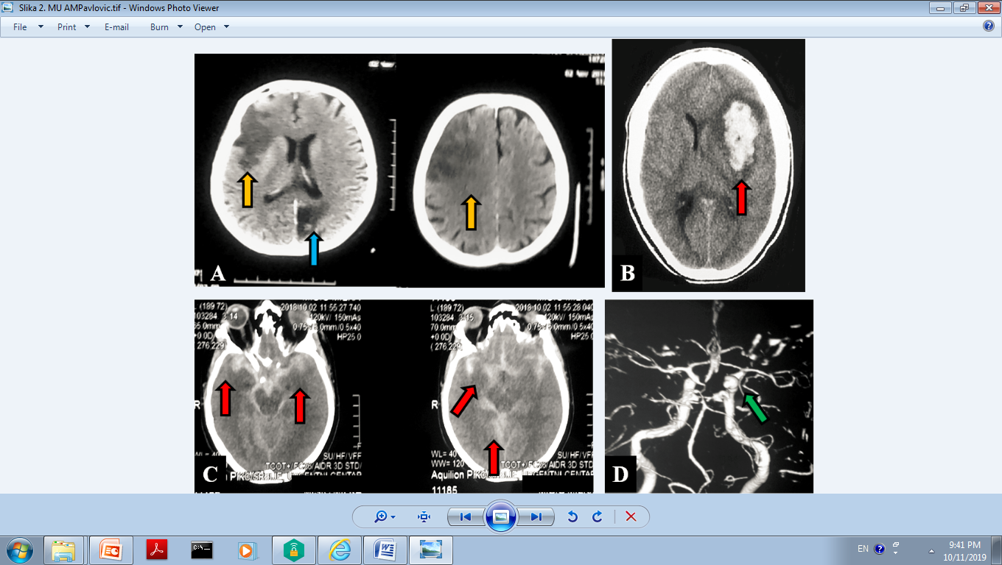
Subarachnoid hemorrhage (SAH)
Life-threatening type of stroke, high rate of mortality (35%) and disability
Extravasation of blood into the subarachnoid space between the pial and arachnoid membranes
Various clinical contexts:
  traumatic (head injury)
  nontraumatic (or spontaneous): ruptured cerebral aneurysm or arteriovenous malformation (AVM)
Nickson, 2014; 2019; Calviere 2015; Kumar 2019

Slide 3
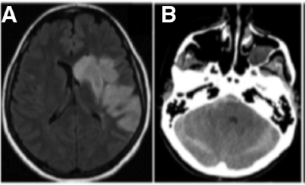
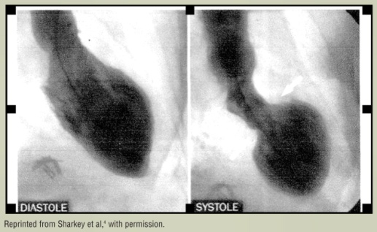

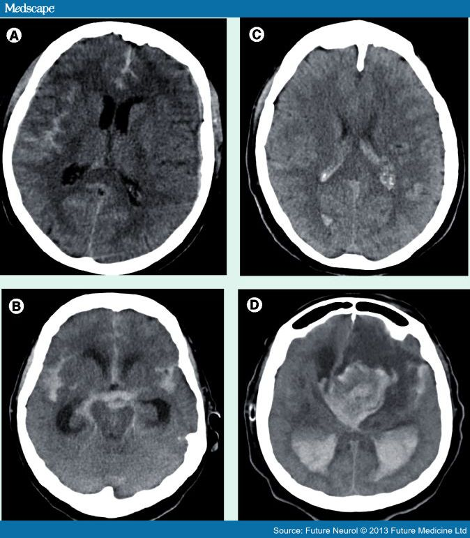
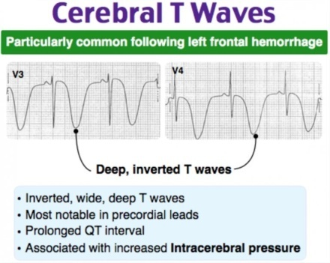
SAH complications
SAH complications: hydrocephalus, rebleeding, vasospasm, seizures, cardiac dysfunction (cerebral T wave, Takotsubo cardiomyopathy)
Vasospasm: up to 70% of aSAH; Day 4-14, resolves at Day 21
Cause: Blood breakdown products in contact with the cerebral vessel wall lead to: 1. delayed sustained contraction of cerebral arteries, 2. structural changes of the vessels characterized by collagen deposition
Mechanisms: endothelial damage, smooth muscle contraction, vascular responsiveness changes, inflammatory and/or immunological processes
Alexandrov 2004; Kumar 2019

Slide 4
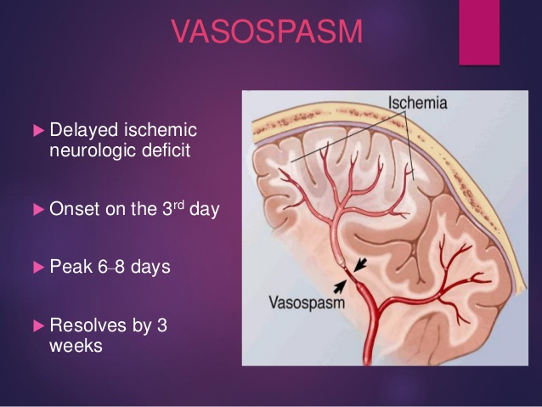
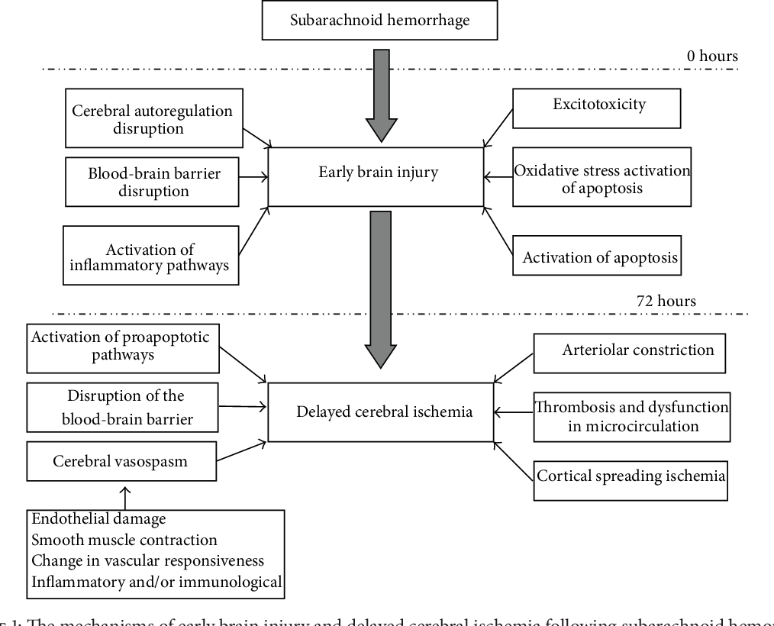
Delayed ischemic neurological deficit (DIND) in SAH
Contractile and structural changes result in severe narrowing of the cerebral arteries that in turn can lead to increased vascular resistance in the conduiting vessels and secondary decreases in cerebral blood flow (CBF) and delayed cerebral ischemia (DCI)
Delayed ischemic neurological deficit (DIND) occurs in ~ 30% of patients, and is the most important secondary cause of deterioration following SAH
New neurological finding not explained by other causes (hydrocephalus, edema, hemorrhage, sepsis, electrolyte disturbances, seizures)
DIND is the main preventable cause of poor outcomes in aneurysmal SAH
Yamaki, 2019

Slide 5
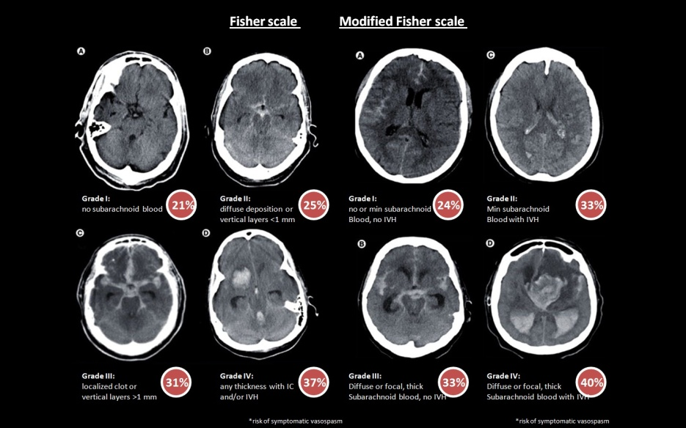
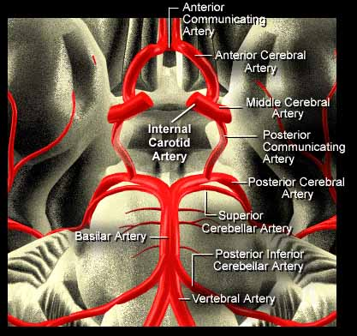
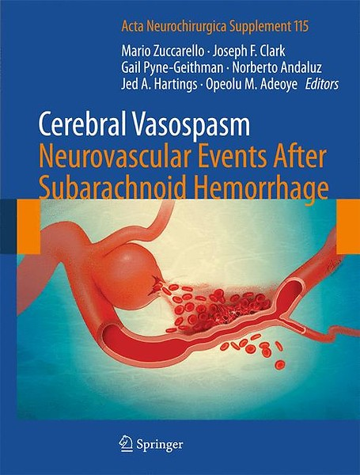
Vasospasm most frequently occurs in the basal cerebral vessels
Most patients will only sustain mild or moderate narrowing of the cerebral vessels and undergo spontaneous resolution without development of DIND
Severe vasospasm can lead to reduction of blood flow to ischemic thresholds and DIND
Compensatory mechanisms: recruitment of collateral circulation, autoregulation of cerebral blood flow and increases in the O₂ extraction fraction

Slide 6
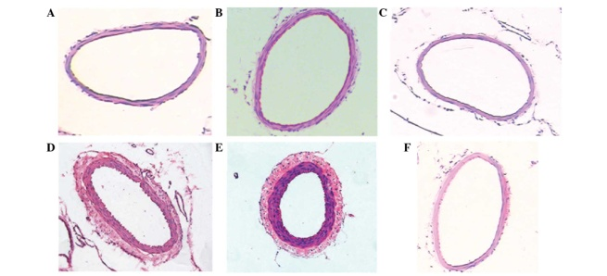
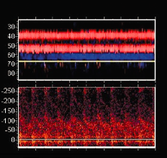
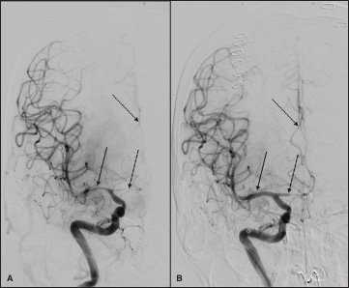

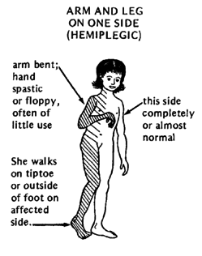
Vasospasm in SAH
Narrowing of the arteries after SAH
Transcranial Doppler (TCD)
Angiographic vasospasm (DSA gold standard)
Symptomatic vasospasm
=
Delayed clinical deficit
Decreased level of consciousness, focal neurological sings -hemiparesis, dysphasia
Rigamonti, 2008; Kumar 2015; Rynkowski, 2019

Slide 7
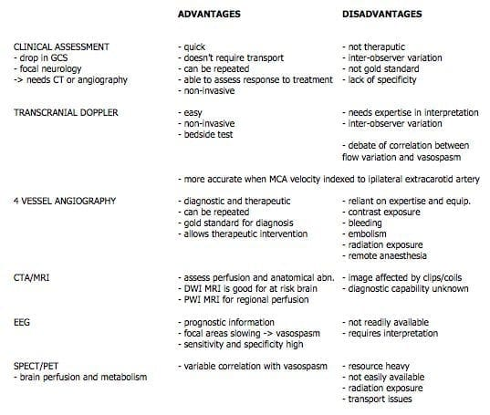
Patient assessment

Slide 8
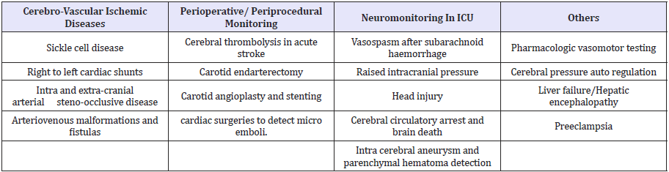
Common clinical applications of TCD

Slide 9
Patient assessment
DSA is gold standard (also allows treatment)
> CTA and MRA
> TCD for large vessels only
TCD:
Compared to CTA, the sensitivity/specificity of TCD for the MCA is quite good (~89-98%)
Precedes clinical vasospasm
Good for frequent follow-up studies

Slide 10
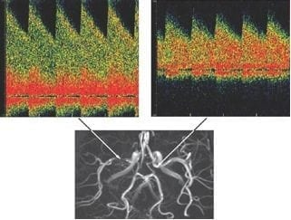
TCD role in vasospasm secondary to SAH
Velocity changes on TCD are generally predictive of vasospasm development and progression of DCI and DIND
From the practical point of view, it is important to obtain baseline TCD measurements in patients with SAH and to frequently (daily or every other day) repeat examinations throughout the hospital stay
Lindegaard 1988; Sloan 1996; Giller 1995; Lewis 1992

Slide 11
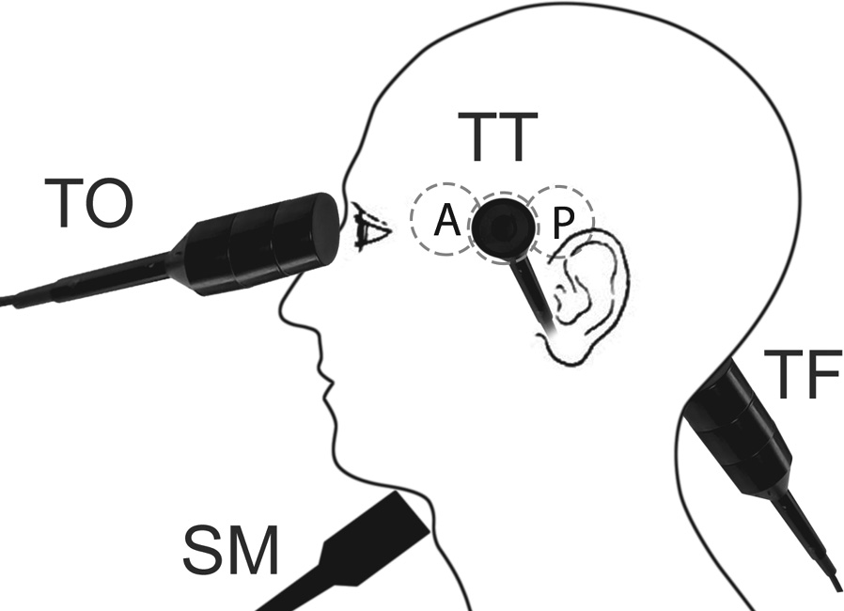
TCD technique
2 MHz probe (low frequency)
probe on temporal bone - measure MFV in MCA
probe to extracranial ICA - measure MFV in ICA
during vasospasm there is an increase in flow velocity through the narrowed segment that is proportional to the reduction in vessel diameter
there is an inverse relationship between cerebral blood vessel diameter and TCD mean velocities
Lindegaard ratio (LR) is a ratio of MFV in intracranial to extracranial carotid artery that differentiates between hyperdynamic flows and vasospasm
Normal MCA mean velocity is < 80 cm/s
Upadhyuay 2018; Nickson, 2019

Slide 12
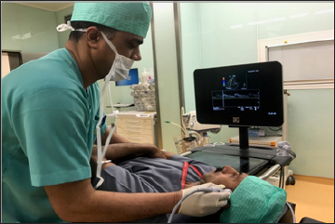
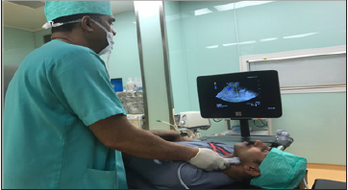

Slide 13
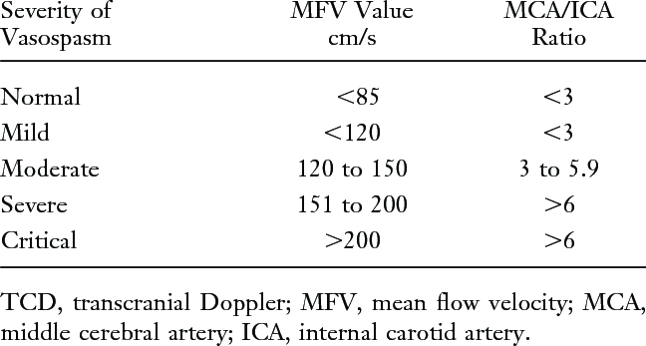
TCD criteria for vasospasm in SAH
LR > 3 indicates cerebral vasospasm
When MCA velocity of > 200 cm/s, a residual vessel lumen is < 1 mm
A change in baseline MCV of > 21 cm/s per 24 h in the first 3 days is diagnostic for vasospasm
Symptomatic clinical vasospasm is often only seen at MVF of 160 cm/s
Abnormally low LR indicates hyperdynamic flows like AVM
Lindegaard 1988; Harshey 2015

Slide 14
Mean flow velocity (cm/s) (MFV) | MCA/ICA MFV (Lindegaard ratio) | Meaning
< 120 | ≤ 3 | Hyperaemia
> 80 | 3 – 4 | Hyperemia+possibly mild spasm
≥ 120 | 3 – 4 | Mild spasm+hyperaemia
≥ 120 | 4 – 5 | Moderate spasm+hyperaemia
≥ 120 | 5 – 6 | Moderate spasm
≥ 180 | 6 | Moderate to severe spasm
≥ 200 | ≥ 6 | SEVERE VASOSPASM
> 200 | 4 – 6 | Moderate spasm+hyperaemia
> 200 | 3 – 4 | Hyperaemia+mild (usually residual) spasm
> 200 | < 3 | Hyperaemia
A modified LR for intracranial basilar and extracranial vertebral artery can also be used to calculate vasospasm in posterior circulation
Topcuoglu 2012

Slide 15
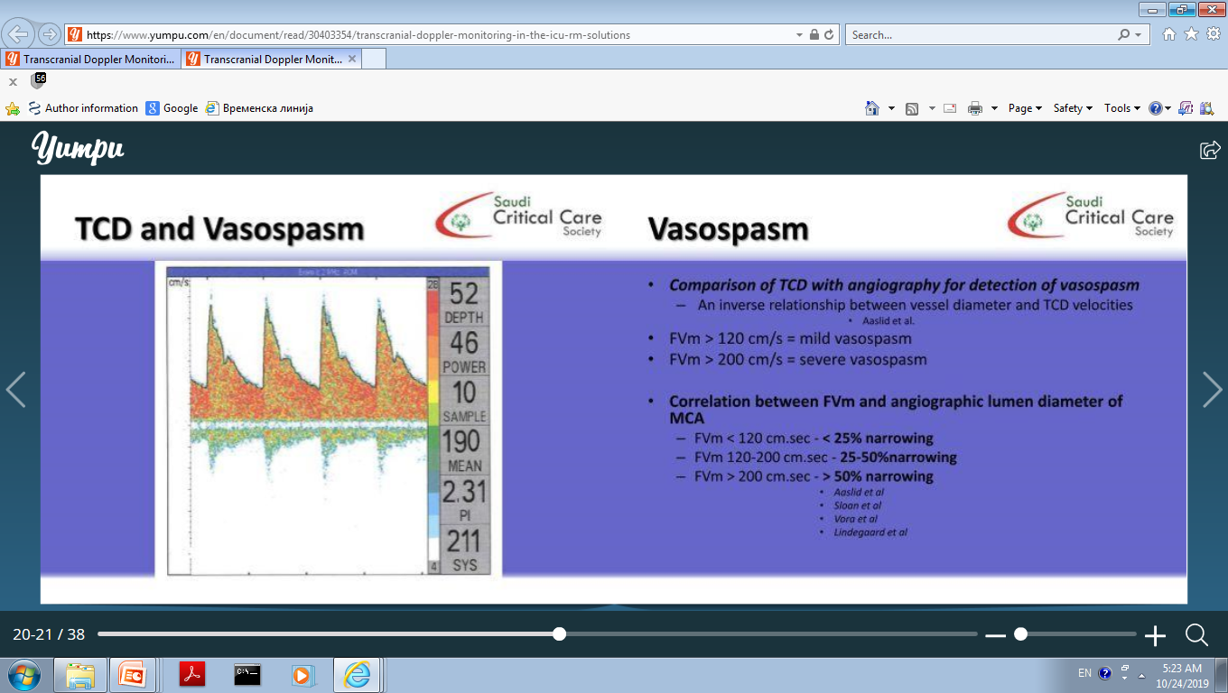
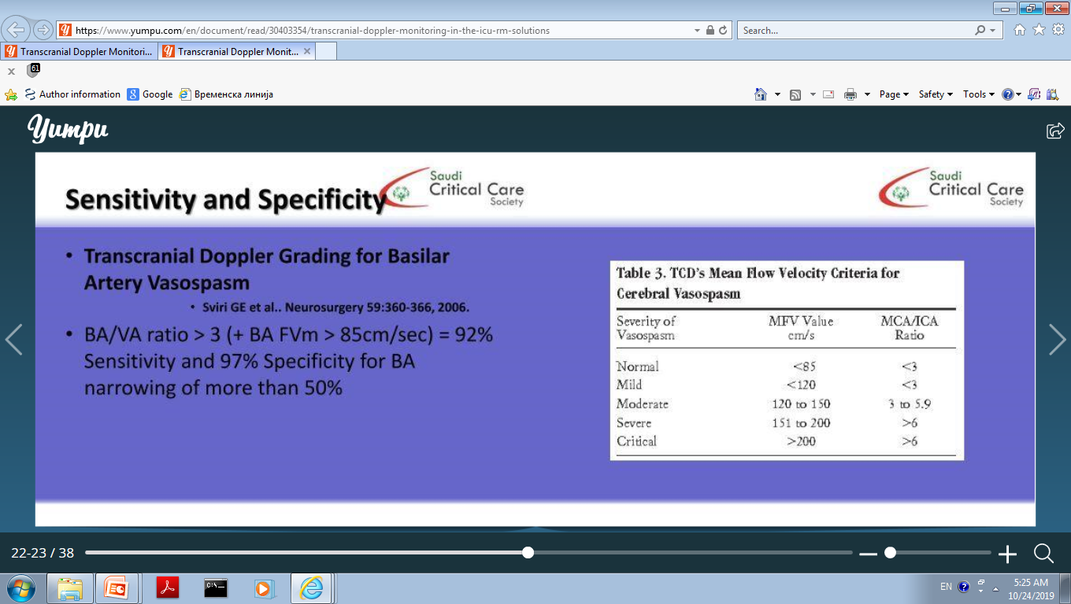

Slide 16
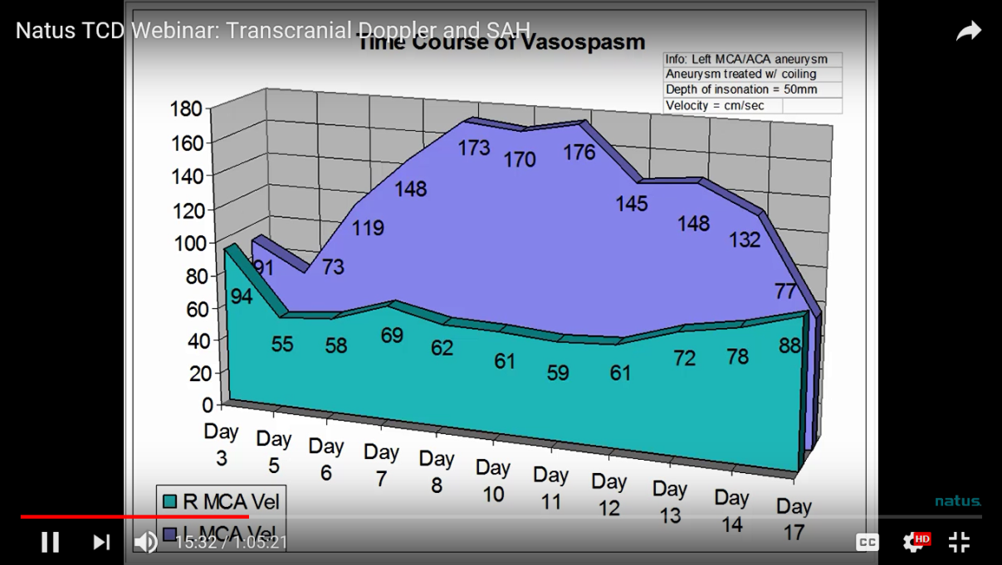
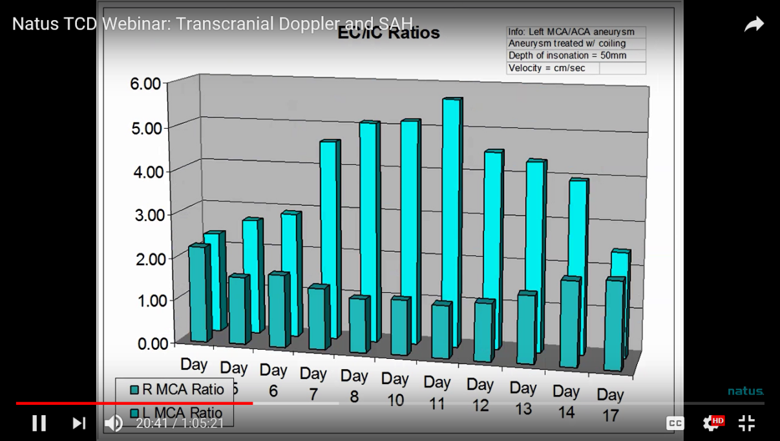
TCD findings and vasospasm dynamic
Onset 4-6 days after aneurysm ruptures
Peaks at 8-10 days and then decrease
Gone after day 14.
Earlier the onset, the faster the rise in velocities, the more vessels involved – THE POORER THE PROGNOSIS - “late bloomers” possible
Cerebral autoregulation impaired after aSAH: an independent predictor of poor outcome, longer hospital stay, worse clinical course and higher rate of infarction

Slide 17
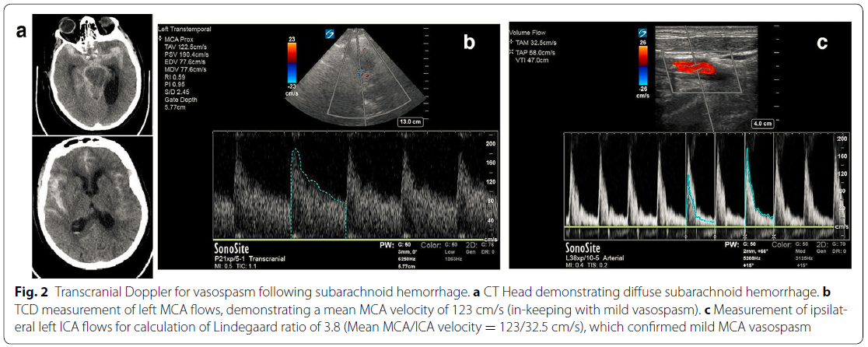
Lau 2017

Slide 18
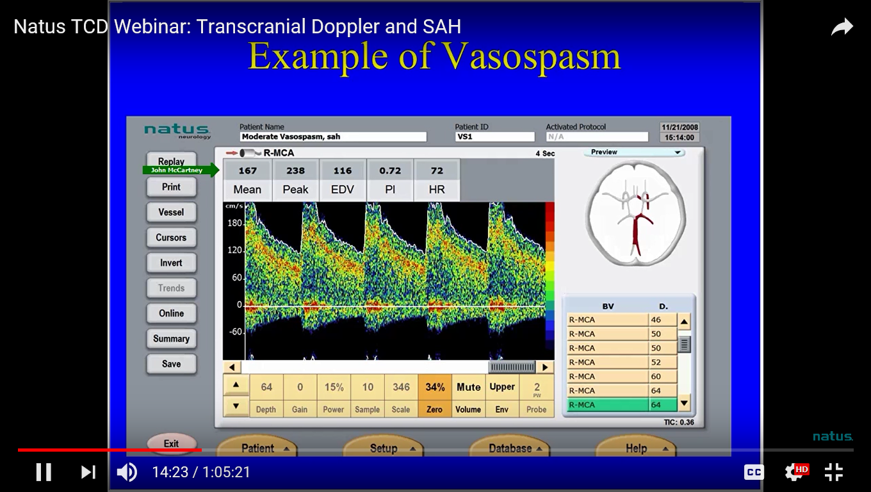

Slide 19
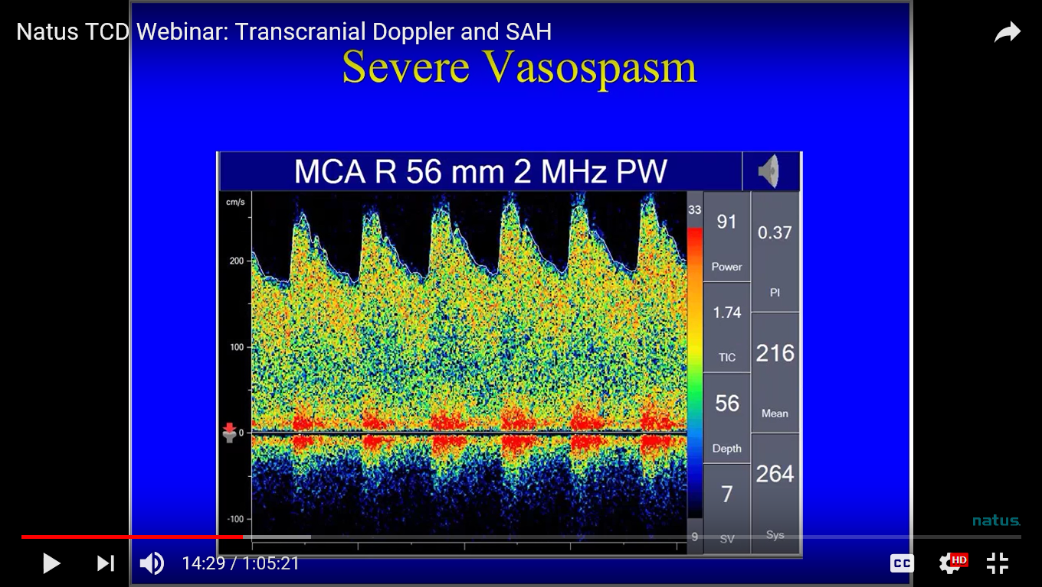

Slide 20
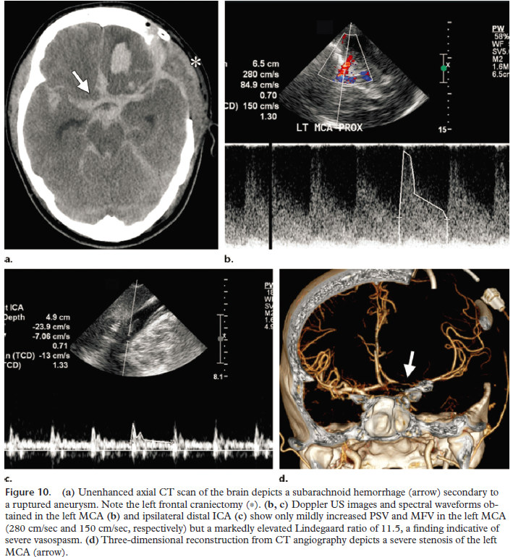

Slide 21
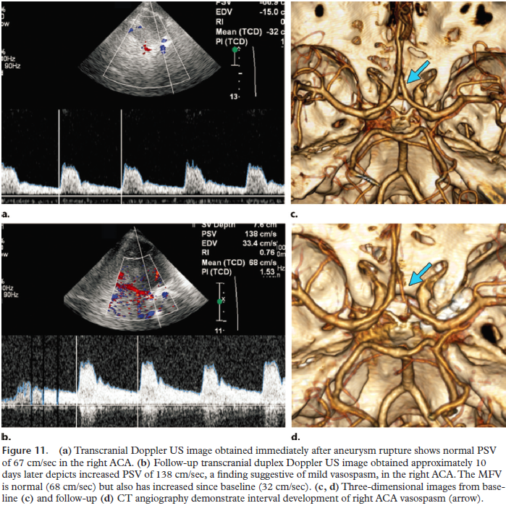

Slide 22
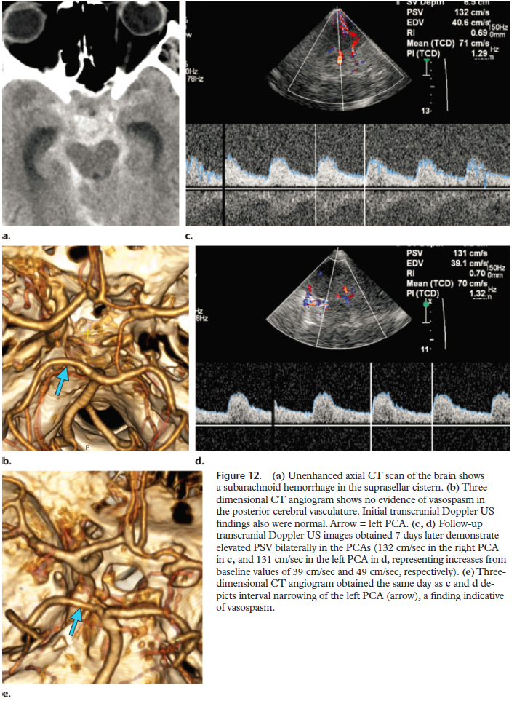
`

Slide 23
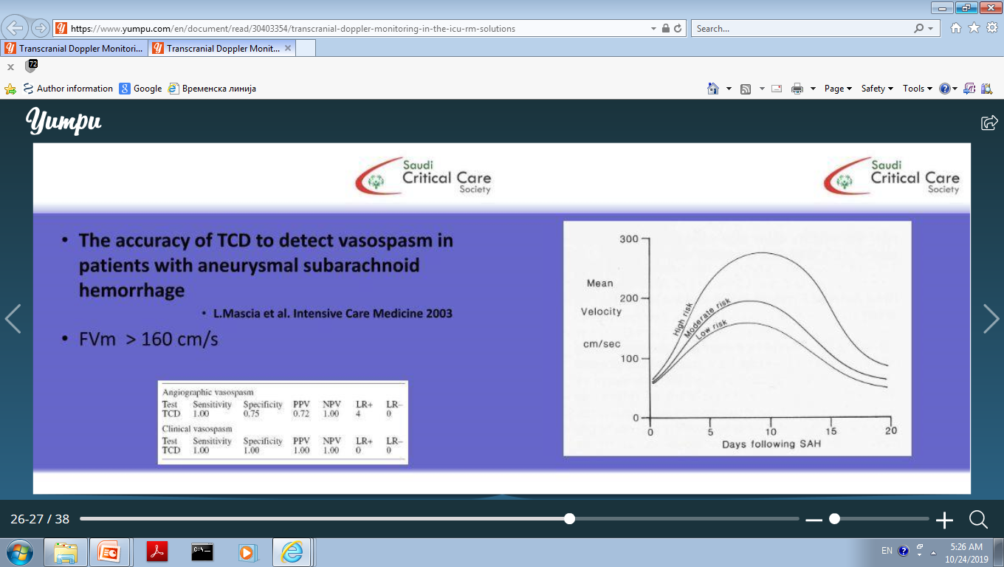
TCD advantages
All relevant professional societies (American Heart Association, American Society of Neuroimaging and American Institute for Ultrasound in medicine) reccommend TCD utilization for vasospasm
90% sensitivity
Easy non invasive bedside test
Can be done in comatose patient as well
Can be repeated on daily basis

Slide 24
TCD limitations
LR does not grade vasospasm but helps differentiate between hyperemia (induces by medical or endovasulcr treatment) versus the onset of true vasospasm
Lower sensitivity/specificity for ACA, PCA and BA
Confounding factors: PaO2, PaCO2, blood viscosity, collateral flow, treatment
Criteria for non-imaging probes
Operator dependent: improper vessel identification, proximal lesions, aberrant vessel course
far-distal spasm can often be predicted by the distribution of blood in more distal locations on the initial CT scan (isolated distal vessel spasm): poor for distal vessels
Poor window

Slide 25
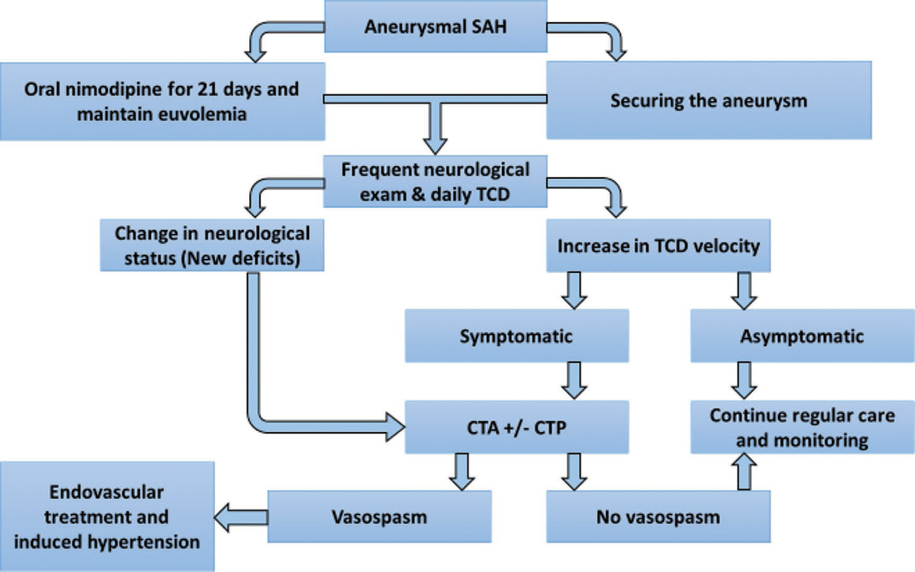

Slide 26
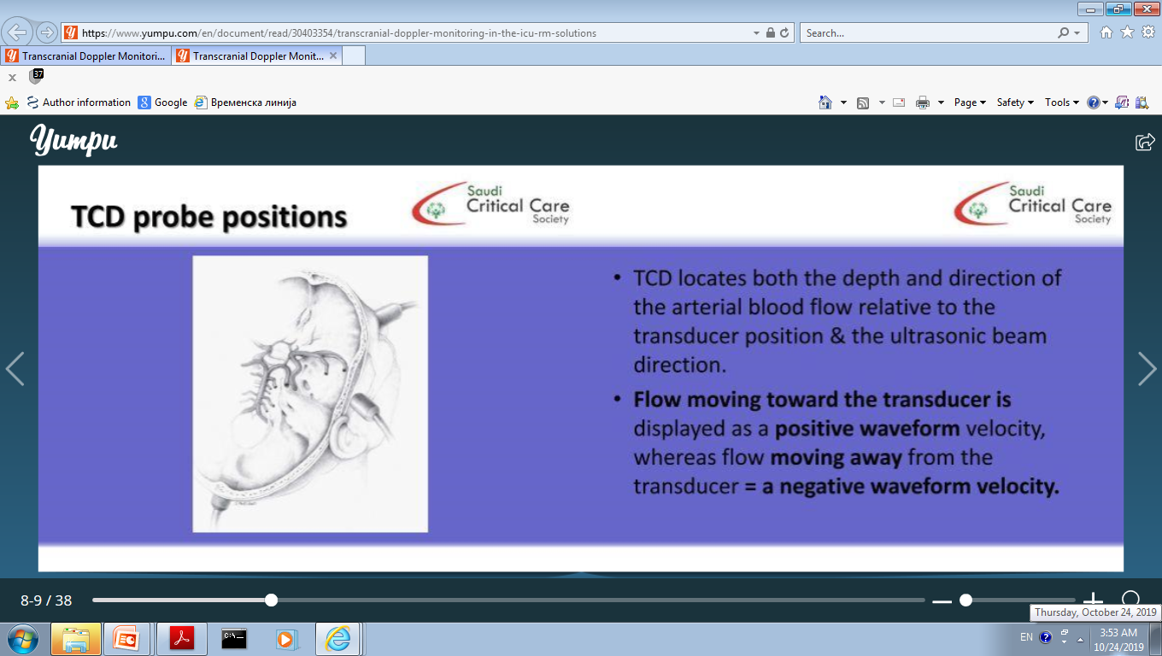
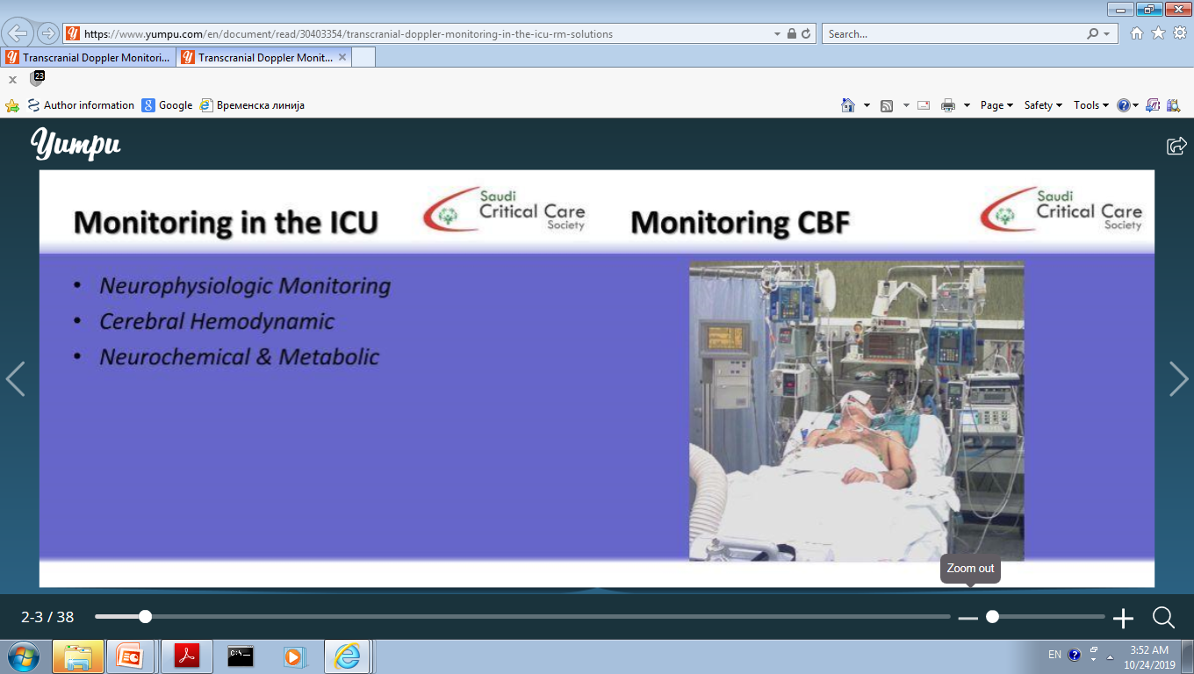
Conclusions
TCD has been studied extensively as a validated screening tool for diagnosing vasospasm, aiding in the management of SAH
TCD can be used to:
Detect asymptomatic vasospasm onset
Follow spasm progression and facilitate therapy
Identify patients with severe vasospasm
Monitor the effect of therapies and interventions
Detect spasm resolution

Slide 27

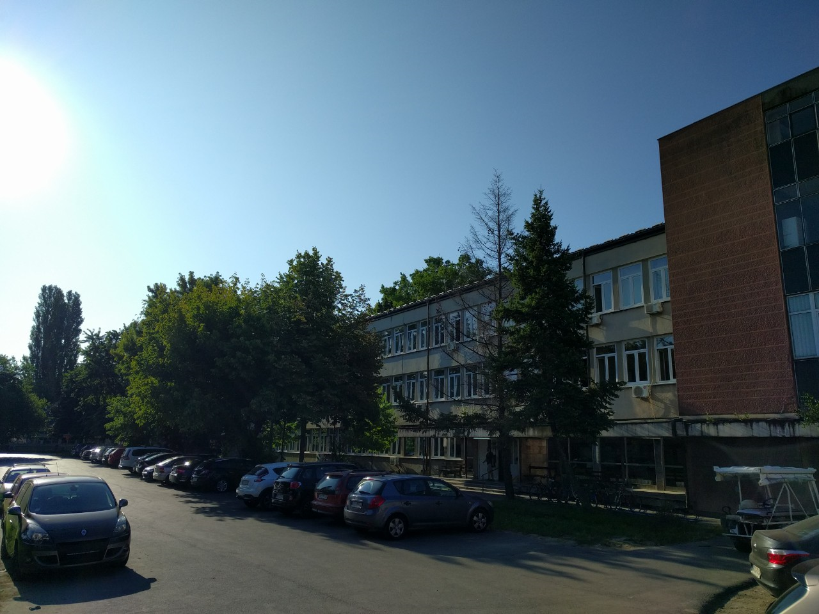
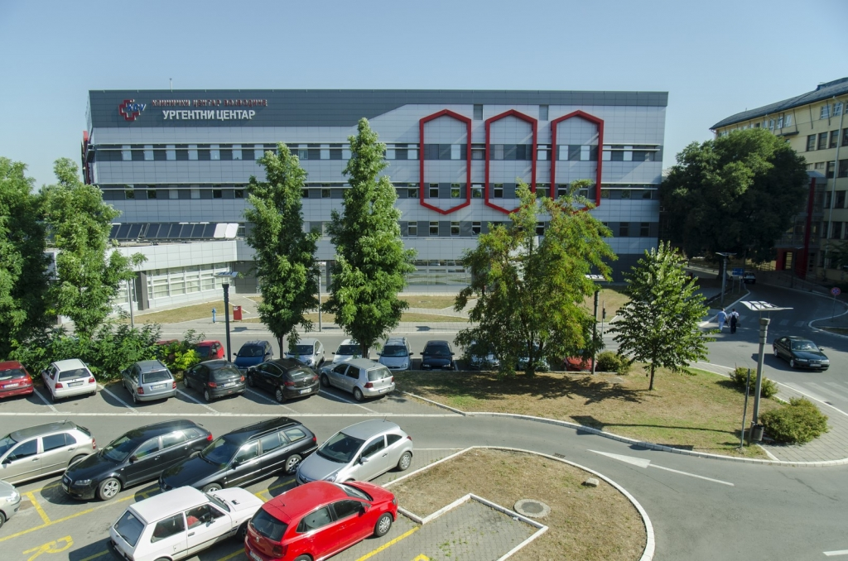
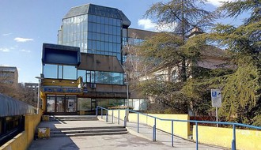
Novi Sad
Neurology Clinic
Emergency Center
Clinical Center of Vojvodina
THANK YOU FOR YOUR ATTENTION

